Slide 1
UCSD Embedded Linux Assignment 4
By
Hsuankai Chang
hsuankac@umich.edu

Slide 2
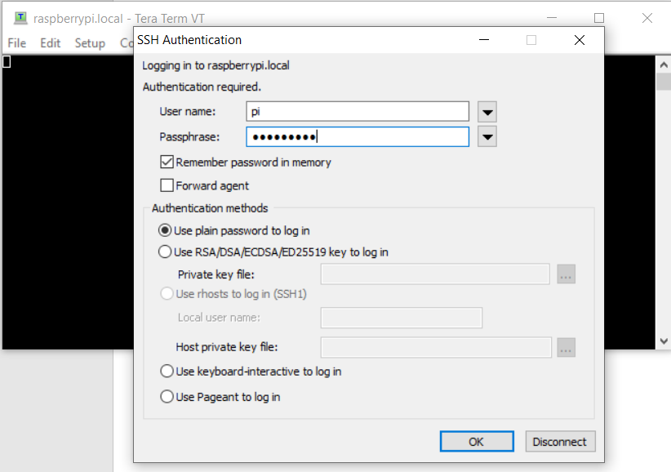
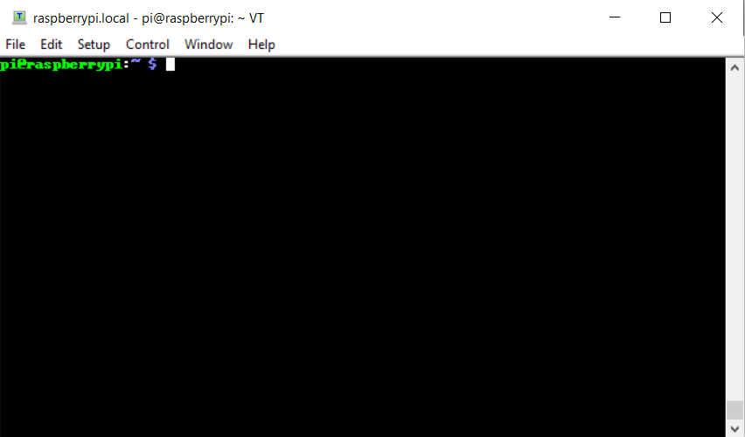
Step 1. Demo 1. RPi GPIO Access From C. Logon to RPi 4

Slide 3
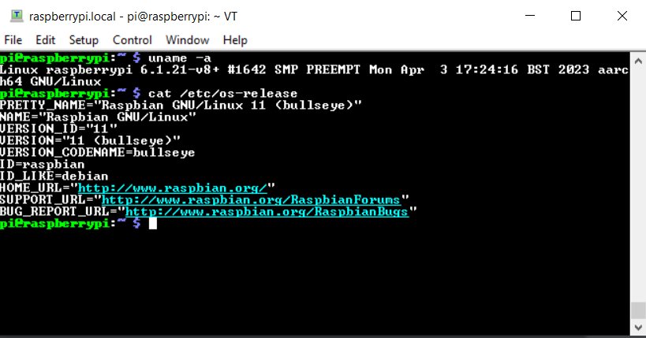
Step 2. RPi 4 Baseline

Slide 4
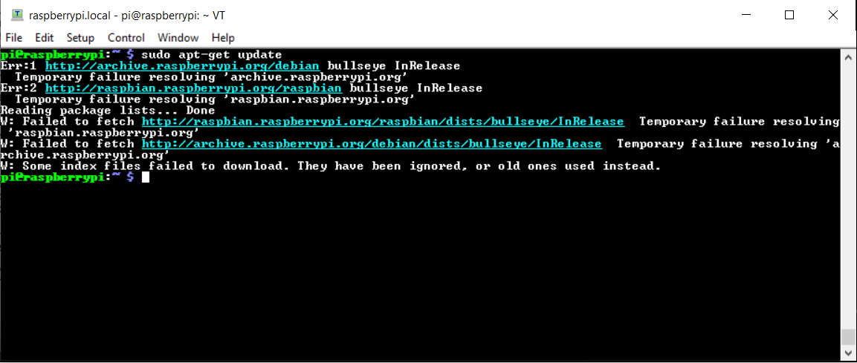
Step 3. sudo apt-get update

Slide 5
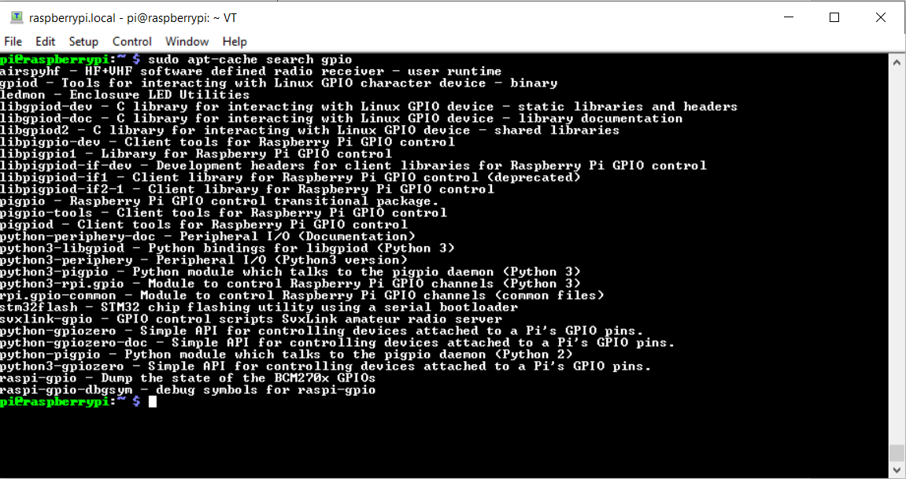
Step 4. sudo apt-cache search gpio

Slide 6
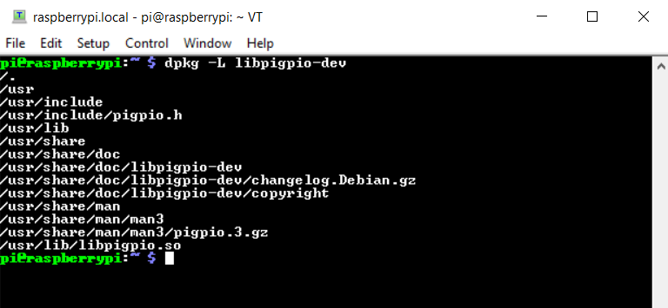
Step 5. dpkg -L libpigpio-dev

Slide 7
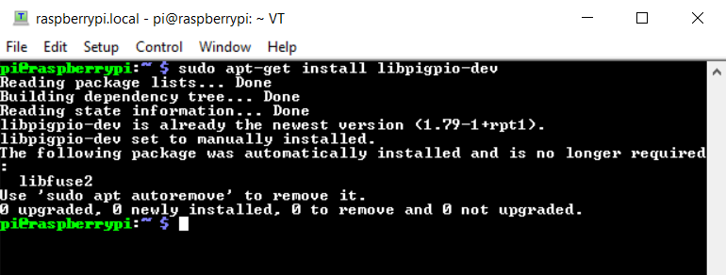
Step 6. sudo apt-get install libpigpio-dev

Slide 8
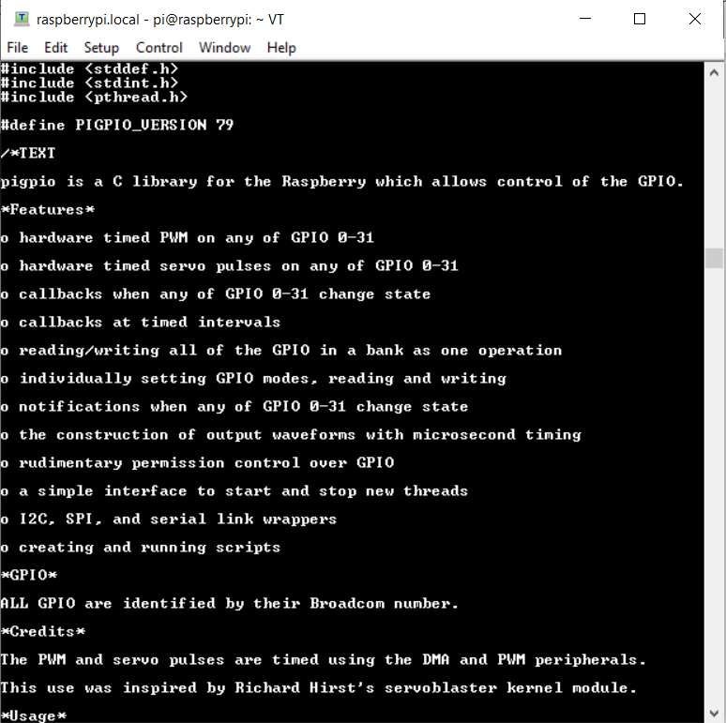
Step 7. View and understand the /usr/include/pigpio.h file

Slide 9
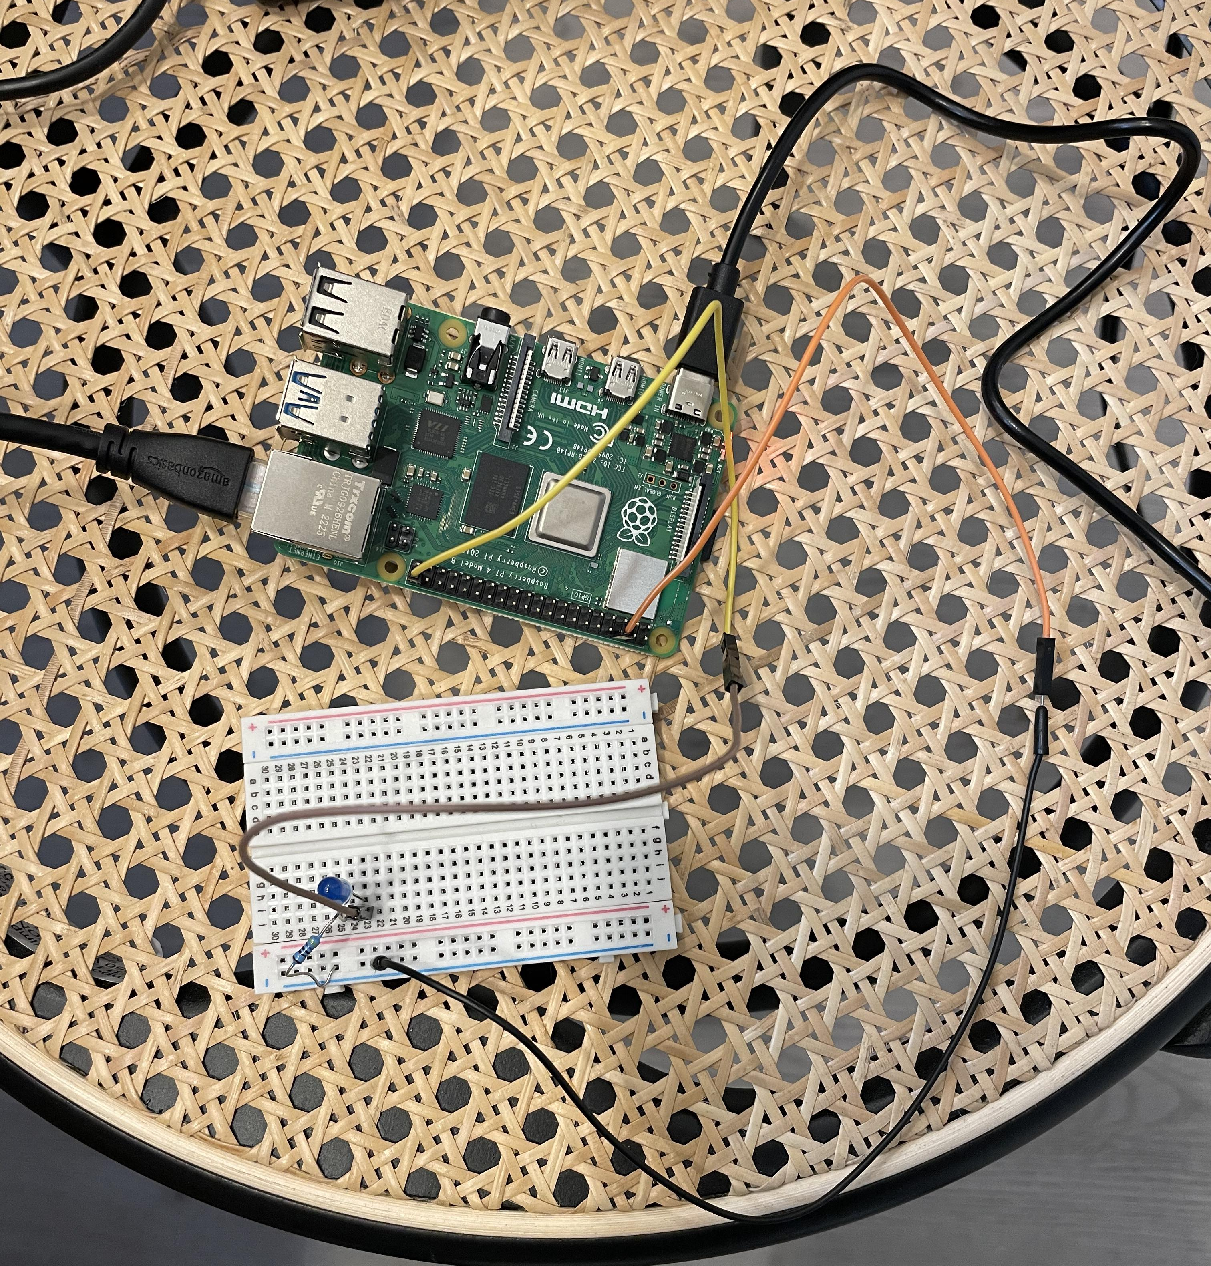
Step 8. Let’s Connect LED to GPIO Pin 21

Slide 10
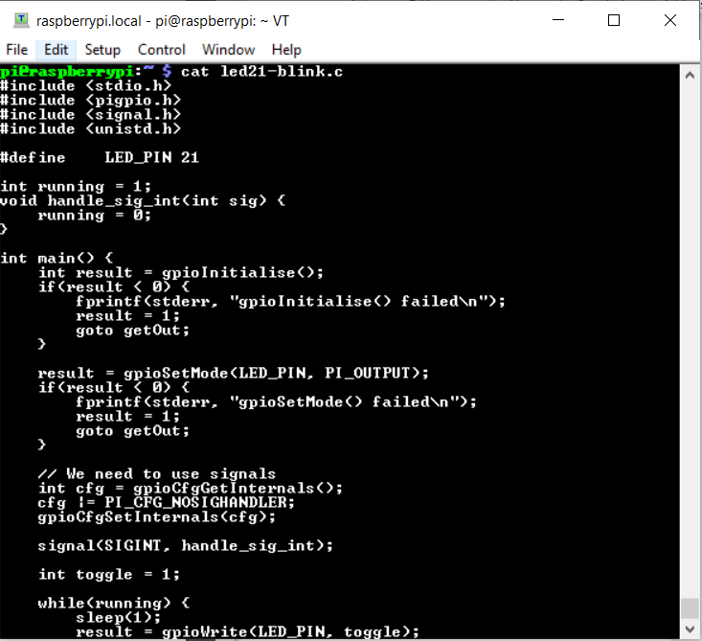
Step 9. led21_blink.c part 1

Slide 11
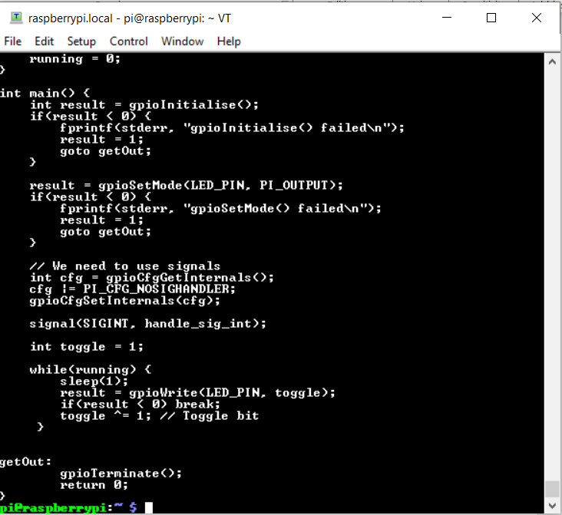
Step 10. led21_blink.c part 2

Slide 12
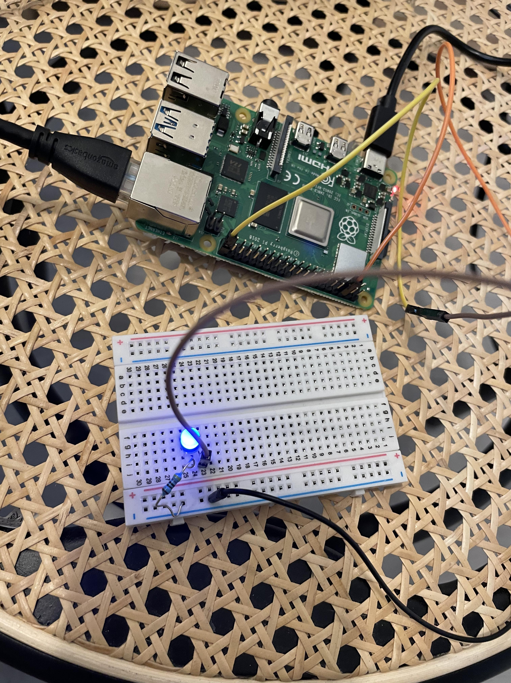
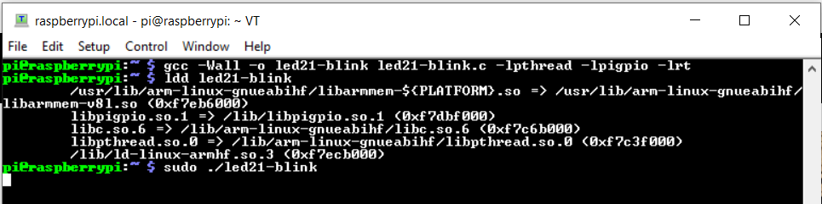
Step 11. build and run the code, the LED is indeed blinking

Slide 13
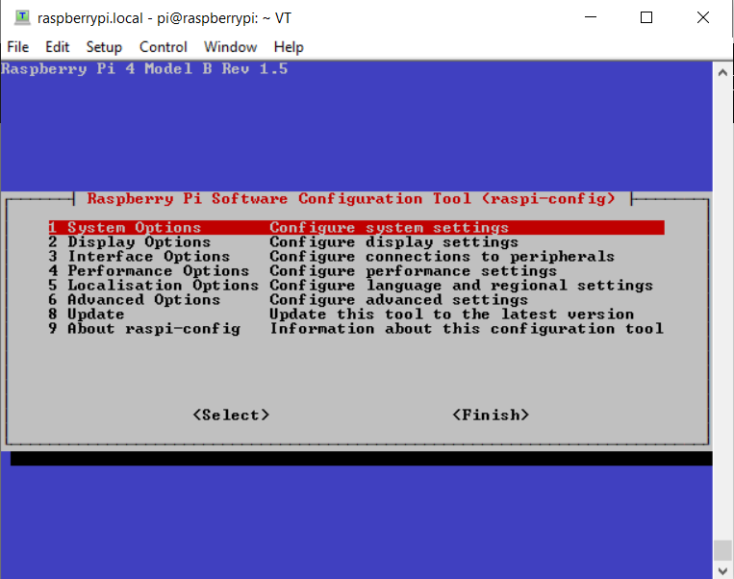
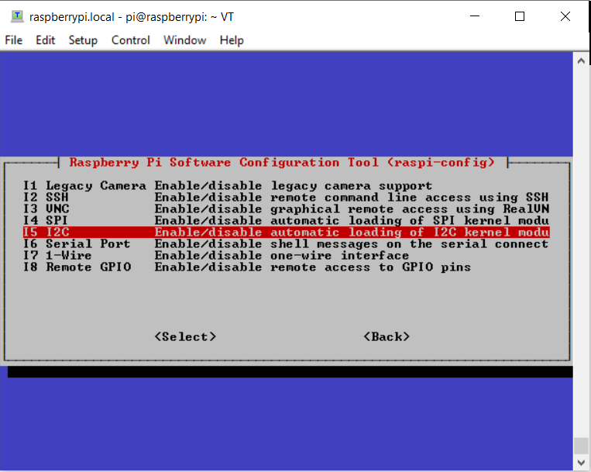
Step 12. Demo 2 I2C Access from C. Configuration of I2C

Slide 14
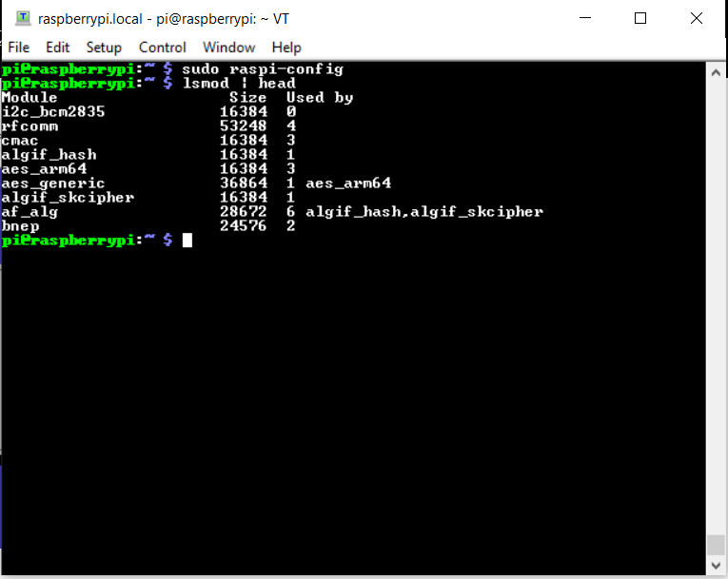
Step 13. lsmod | head

Slide 15
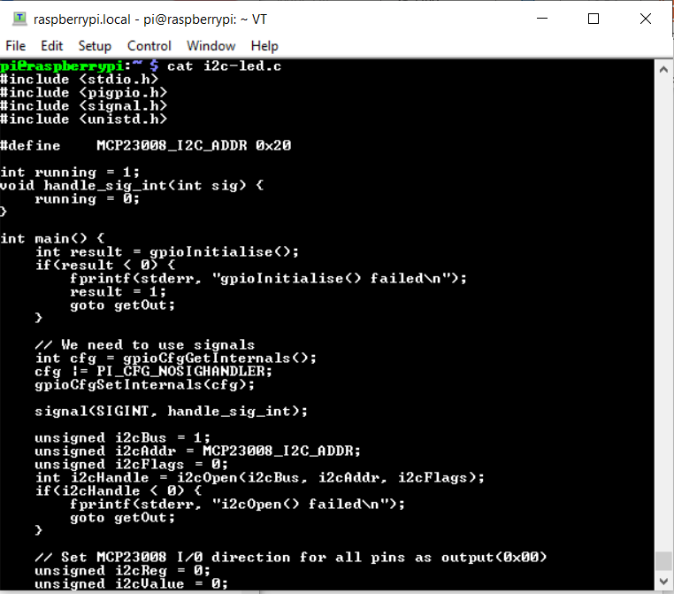
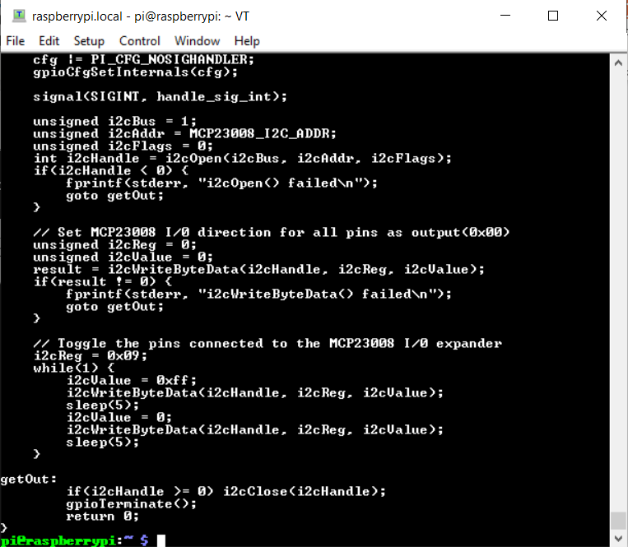
Step 14. i2c-led.c file

Slide 16
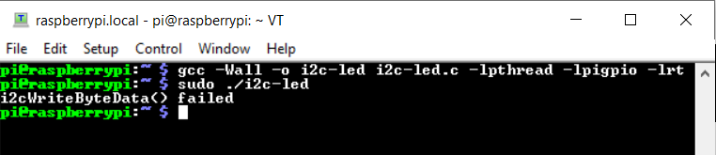
Step 15. build the code, build is successful. I do not have MCP23008 to test, so this is the end of my demo

